Slide 1
L6 Group 1
Amy Potter
Daniel Pokladek
Notes:
So i dont forget: Praesul’s daily tasks - random tasks to complete per day to get rewards?

Slide 2
Game Overview
Designed for mobile devices
Tablet Devices
Possibility to port to mobile phones
Single player
Casual game
Easy fun / Focus on expression and relaxation
Ages 25 - 50

Slide 3

Market Psychographic
Patricia
37 year old
Daily commute
Gardening, cake decorating and bird watching
2 children and a pet cat called Tigger
Notes:
Amy: Patricia is a 37 year old woman from Peterborough who commutes to London for work on a daily basis. She enjoys gardening, cake decorating and bird watching during her spare time and uses Pinterest to find interesting recipes that she can experiment with. In addition to her two children, Patricia and her husband have a pet cat called Tigger. The idea of nurturing is important to Patricia as she is an animal lover and is highly eco-conscious. She is also extremely tidy and prefers that her house is meticulously organised is she can help it.

Slide 4
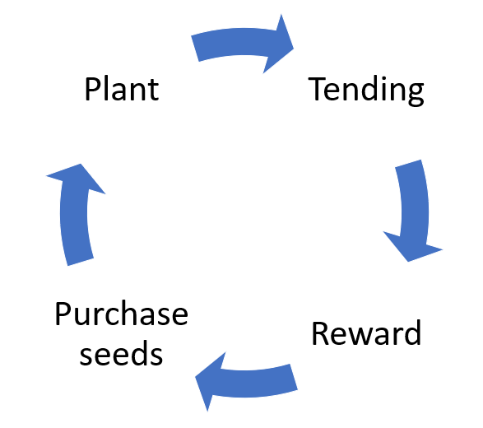
Core Game Loop
Notes:
Amy: As shown in the prototype, players are presented with an object in the middle of the screen. They must drag this object into the appropriate category, which will drain their energy by one. As an element of progression, players will be able to unlock further categories and objects to sort, which will allow them to obtain more rewards.
In order to continue sorting, players are encouraged to harvest their plants in order to gain stars and replenish their energy. In order to prevent players having to wait for a long time, the energy replenishes itself over time. However, the energy via this method is lower in value and thus is a suboptimal choice over growing and harvesting plants.
Over time, sorting and planting objects will become less of a priority for the player as their planet begins to look the way they envisioned. To encourage the player to continue playing, we have considered the integration of tending mechanics, such as pruning and watering, which will offer the player new rewards.
As shown in the prototype, players are presented with an object in the middle of the screen. They must drag this object into the appropriate category, which will drain their energy by one. As an element of progression, players will be able to unlock further categories and objects to sort, which will allow them to obtain more rewards.
In order to continue sorting, players are encouraged to harvest their plants in order to gain stars and replenish their energy. In order to prevent players having to wait for a long time, the energy replenishes itself over time. However, the energy via this method is lower in value and thus is a suboptimal choice over growing and harvesting plants.
Over time, sorting and planting objects will become less of a priority for the player as their planet begins to look the way they envisioned. To encourage the player to continue playing, we have considered the integration of tending mechanics, such as pruning and watering, which will offer the player new rewards.

Slide 5
Starting Over
Nuts and bolts approach to design
Focus on player onboarding
Player types
Expressive
Collaborators
7 rules of gamification

Slide 6
Key Changes
Players grow plants in their inventory
Allows player to progress without having to decorate their planet in a way they wouldn’t want to
Multiple and single yield objects
Optimal time to collect
Grouping objects to increase yield
In-game currency
Players don’t know what the seeds will grow into
Inventory items are greyed out, until fully grown

Slide 7
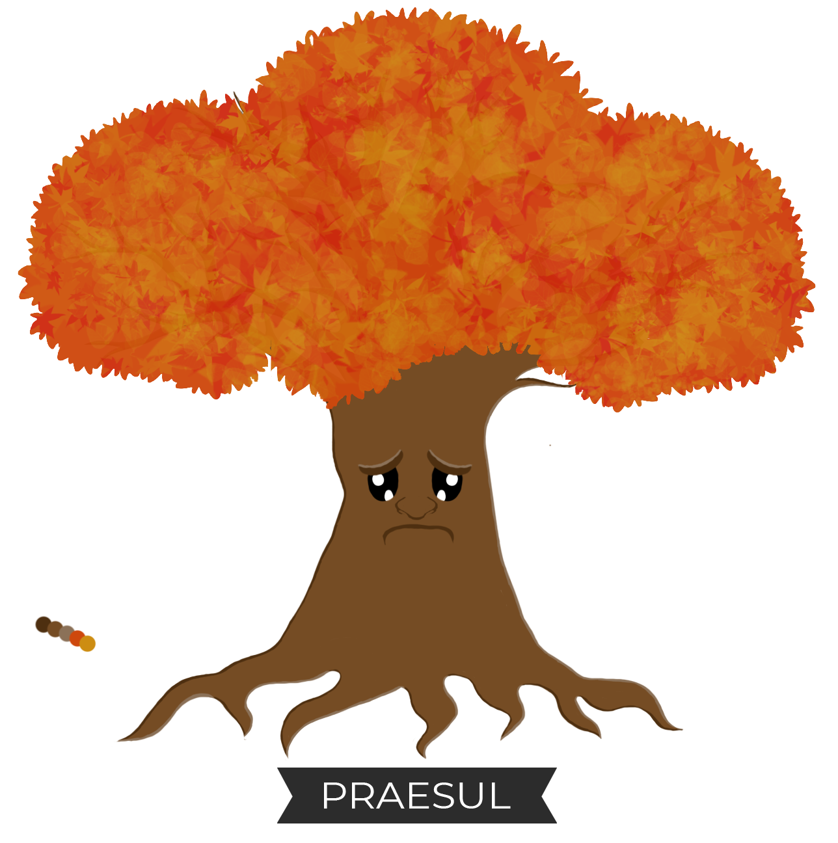
Design Features Kept
Praesul (Quests/Tasks)
Planting
Tending

Slide 8
Code Features Kept
Saving & Loading of Player Progress
Inventory System
Inventory is now a backpack
It works in the same way
Progress Journal
Praesul
Still gives quests to player
Now has introduction dialogue

Slide 9
Features Scrapped and Why
Sorting System
Eventually becomes an obstacle for player
Circular landscape
Unintuitive and awkward for player

Slide 10
What to Achieve in 8 Weeks/Deliverables
Finished Vertical Slice
Finished & Polished Tutorial
10 Minutes of Tutorial Gameplay
Finalise and Implement Mechanics
Create required assets
Finalised Art Assets
Finalised Code
Playtesting of Tutorial
Playtesting carried out with our psychographic

Slide 11
Milestones
7th March
Finished Mockup of Tutorial
14th March
Fully Implemented Praesul Greeting
21st March
Implemented any new(?) mechanics
28th March
Vertical Slice implemented with placeholder assets
4th April
Playtesting to polish the game
2nd May
Bug fixing & Additional Polish
9th May
Finished & Polished Tutorial

Slide 12
Any Questions?
Notes:
Pls no

